Slide 1
Getting Git, MSVC, CMake
Dr. Scott Nykl
CSCE593

Slide 2
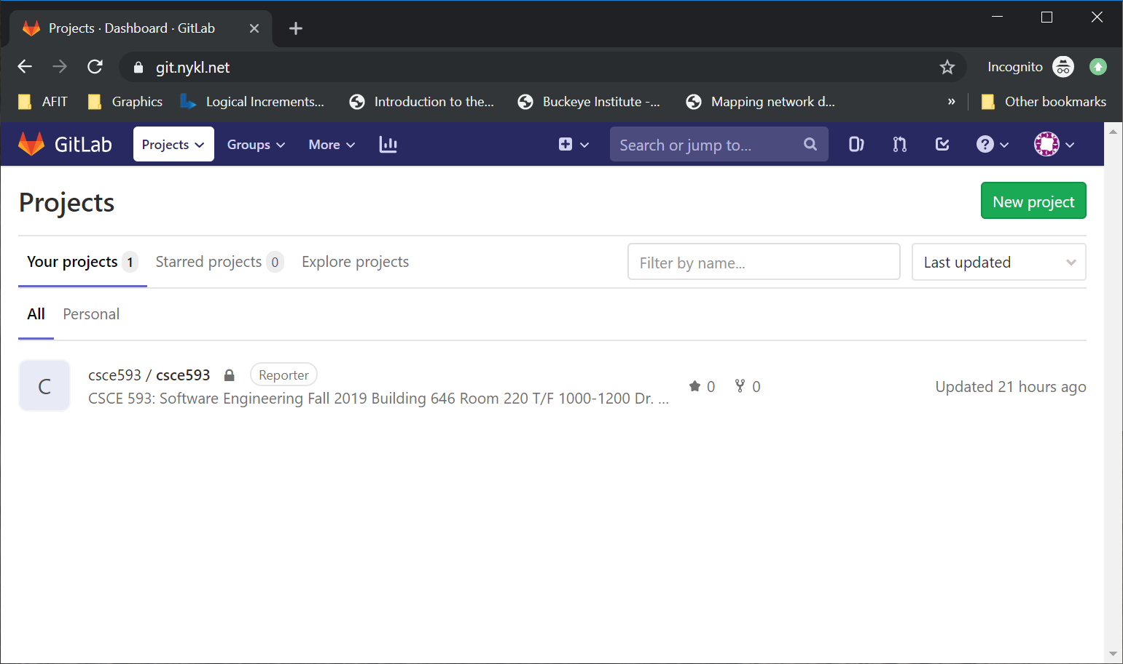
Login to https://git.nykl.net
Username is first.last (as in first.last@afit.edu)

Slide 3
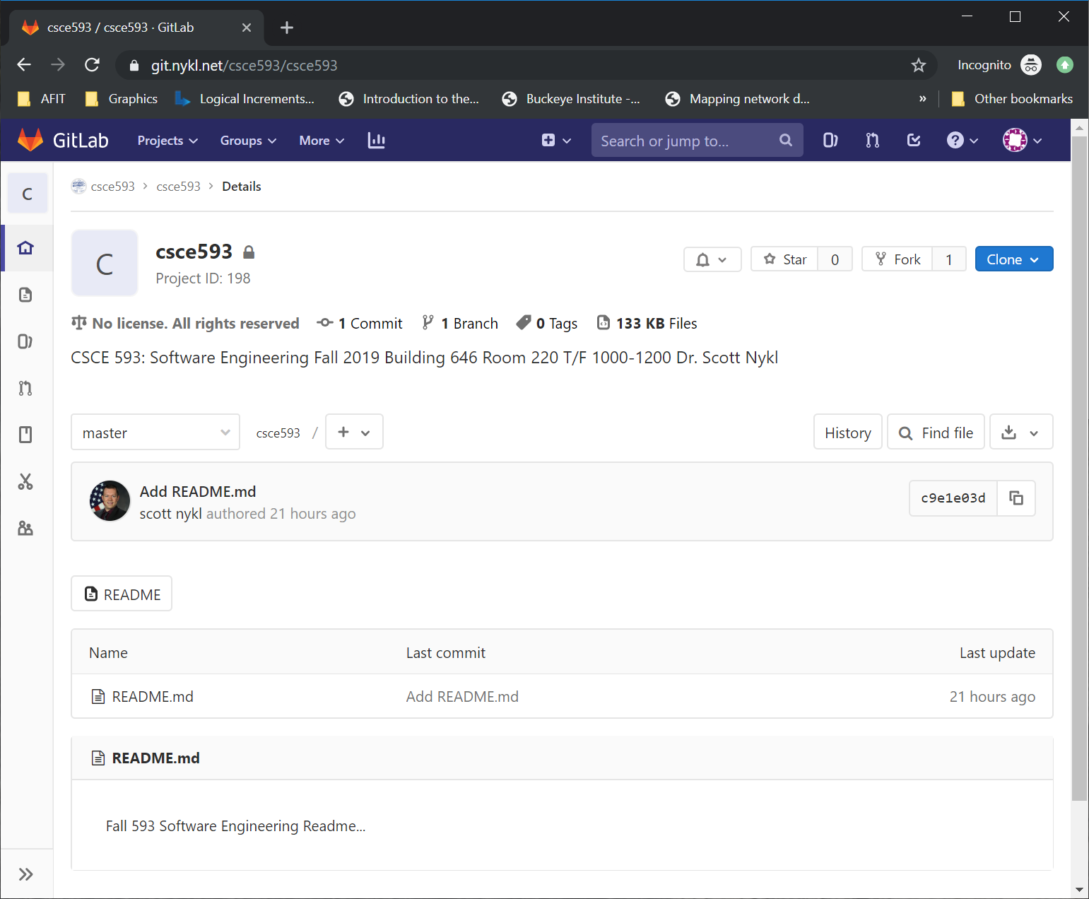
Fork csce593/csce593

Slide 4
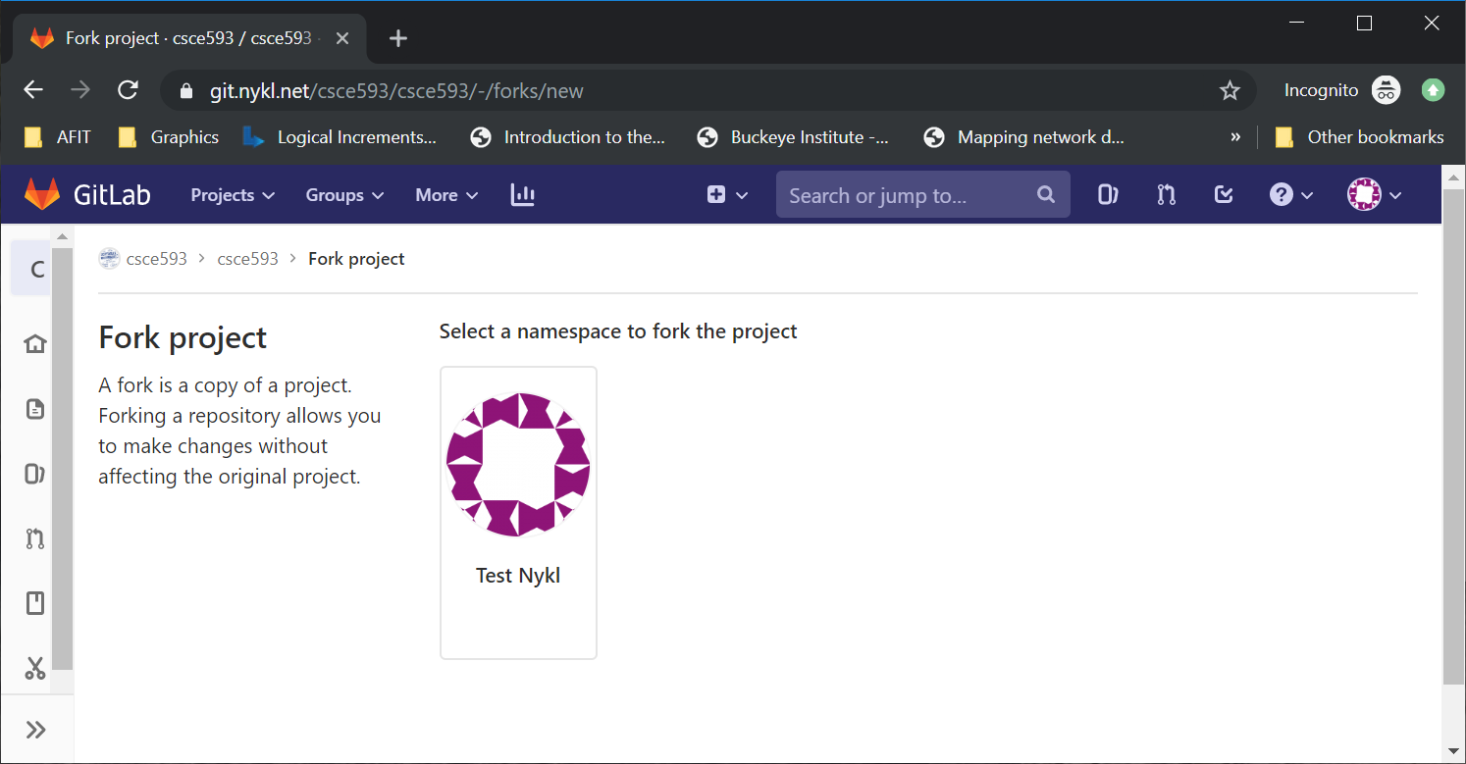
Confirm Fork

Slide 5
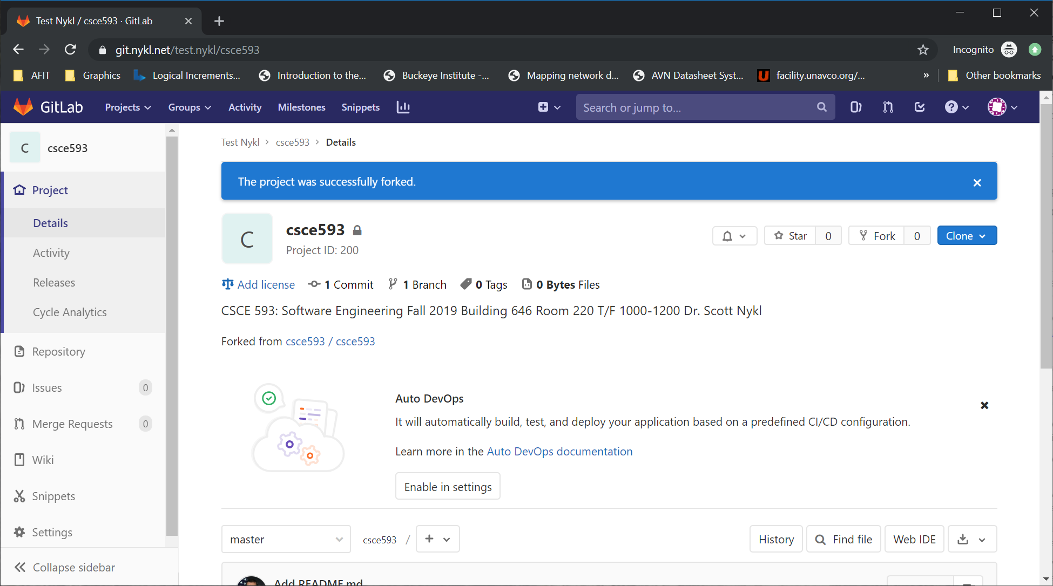
Confirm Success

Slide 6
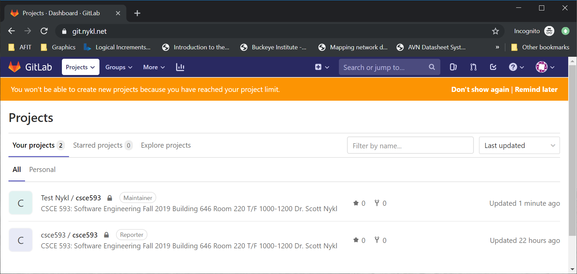
Now 2 Projects Exist!

Slide 7
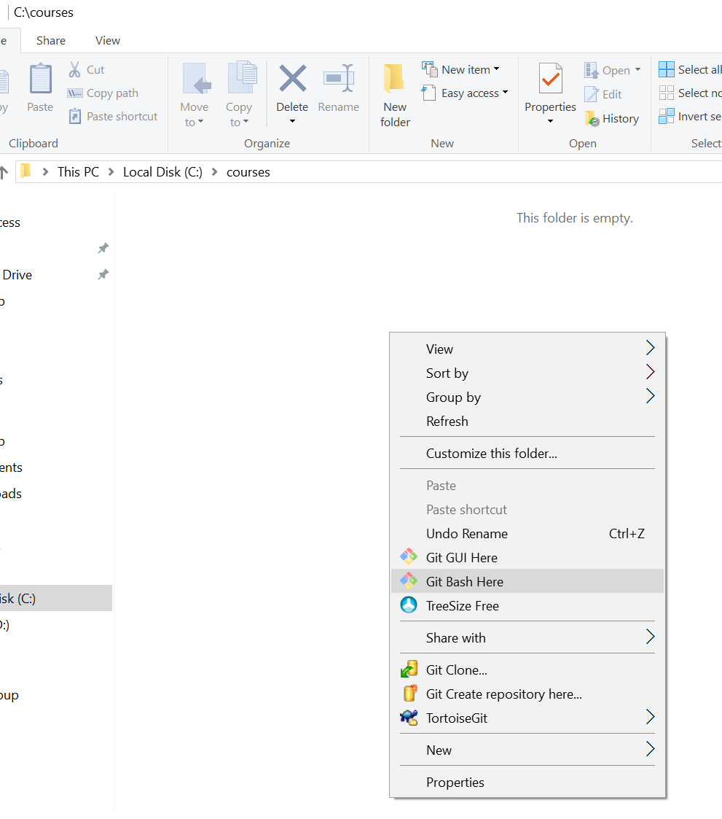
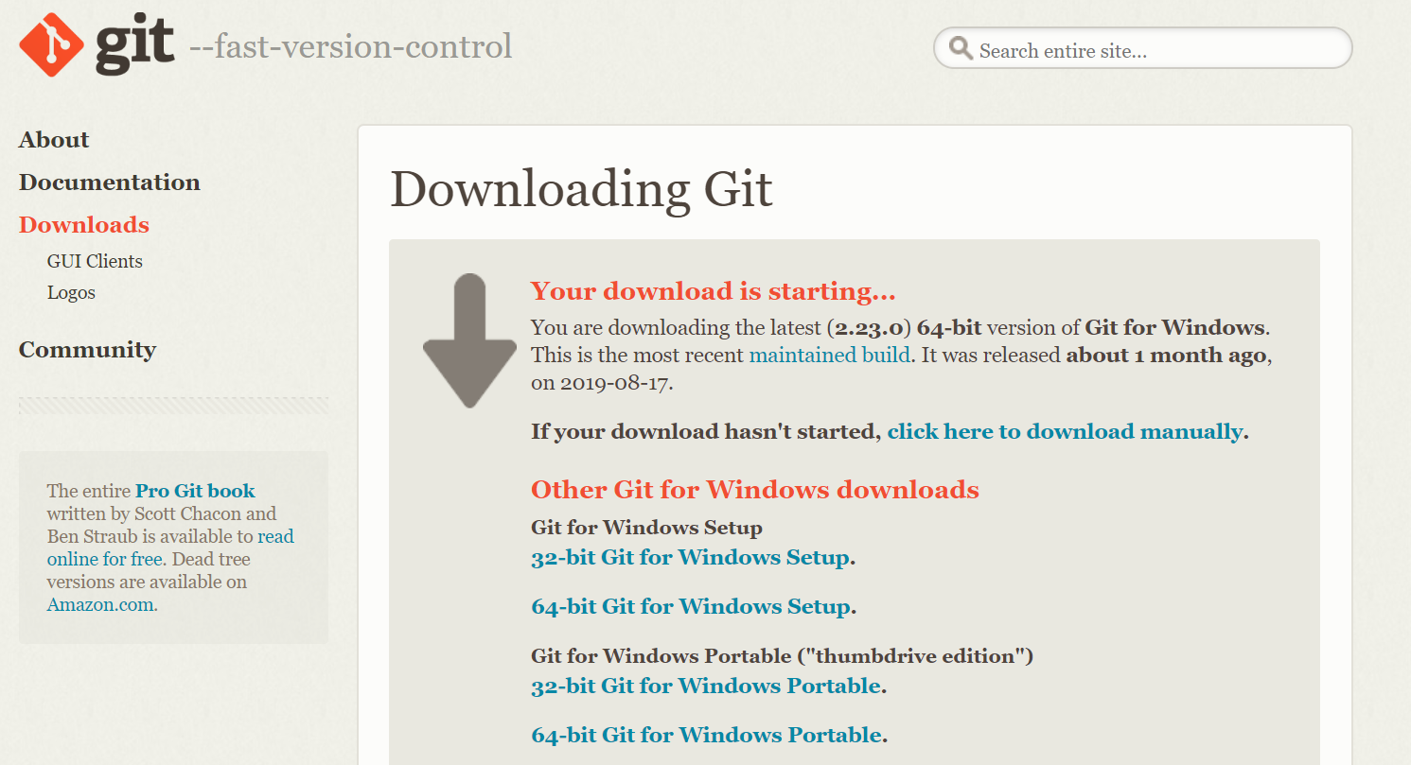
Setup GIT on Your Machine
https://github.com/git-for-windows/git/releases/download/v2.23.0.windows.1/Git-2.23.0-64-bit.exe

Slide 8
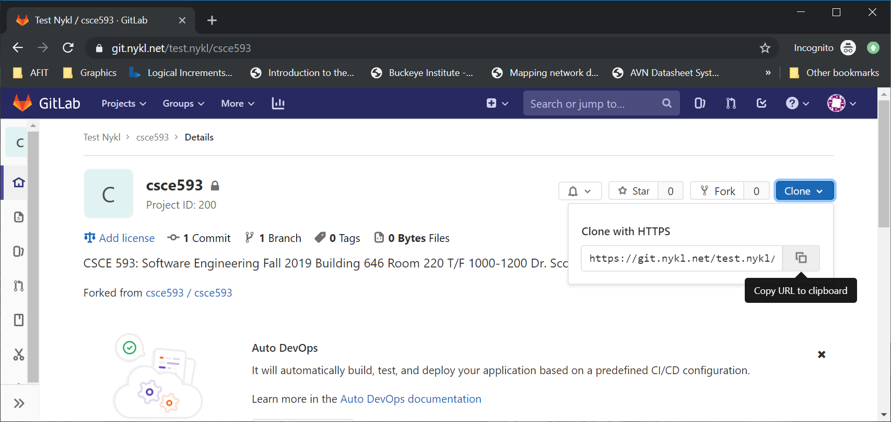
Copy URL to Your Forked Git Repo

Slide 9
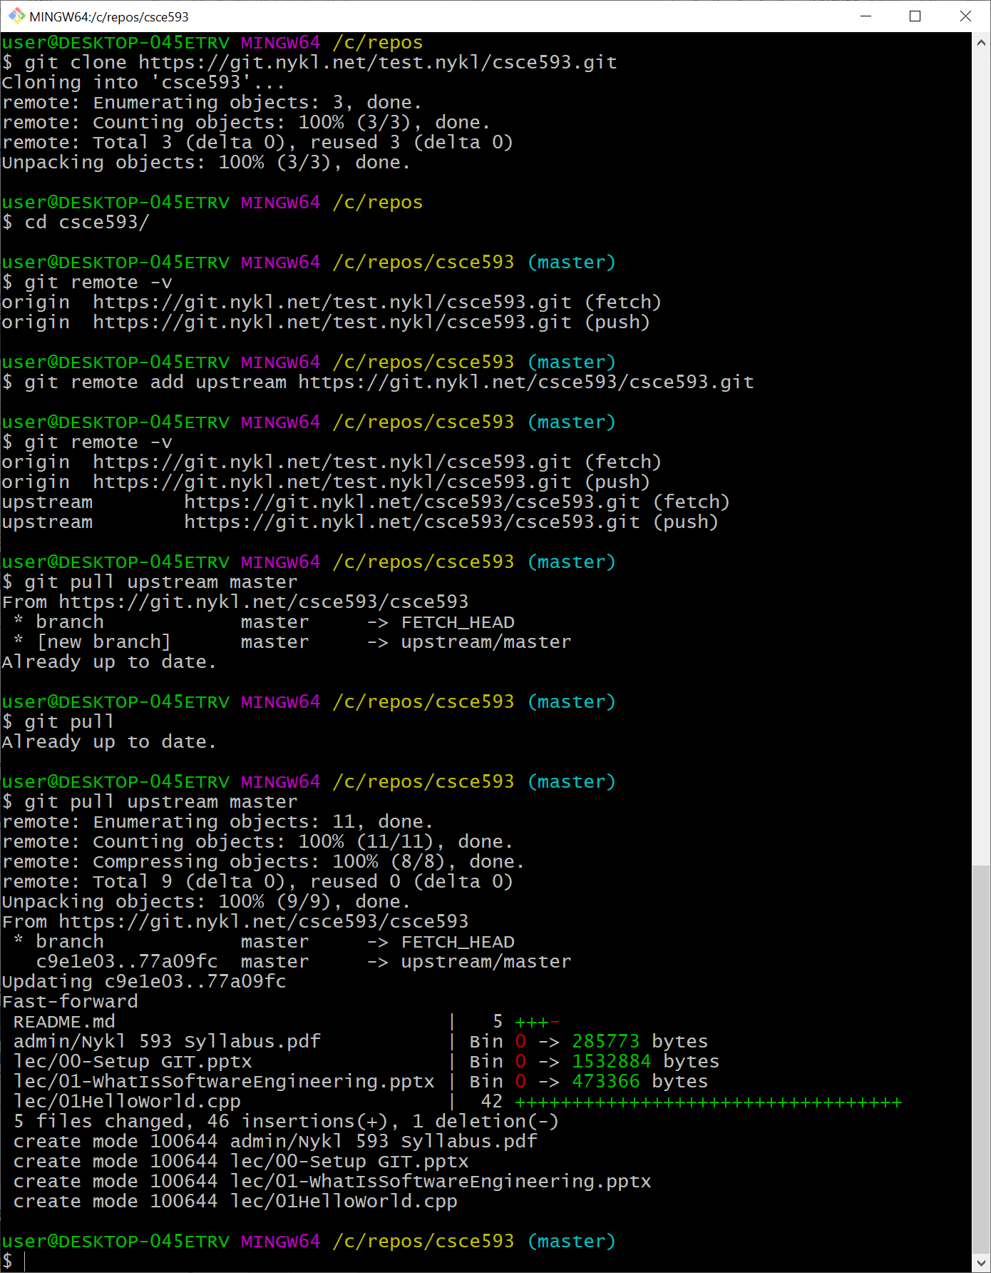
Your Username here
Clones files from your forked repository to your local hard drive at /c/courses/csce593
Tells your local repository to add an upstream branch (pointing to the original repo from which you forked). This way, when I add new files to that repo, you can pull them into your forked repo.
View all remotes associated with your local repository
Pull latest files from the upstream (original, non-forked repo) into your local repo. You may then push these files to your forked repo on the server via git push.
At a later time, the professor will add content to repo. The student (you) can immediately get this new information by pulling from the upstream repository on the master branch. i.e., git pull upstream master
These new files are now on your hard drive or have been updated to newer versions.

Slide 10
What to Download & Install
GIT for Windows (latest 2.23.0) https://git-scm.com/download/win
Nice GUI Front End for GIT TortiseGIT https://tortoisegit.org/
CMake 3.15.3 – Cross platform build tool https://cmake.org/download/
MSVC 2019 C++ Compiler & IDE https://visualstudio.microsoft.com/vs/
Windows Subsystem for Linux (WSL) (https://docs.microsoft.com/en-us/windows/wsl/install-win10)
Install Ubuntu 18.04
Login and install GNU Compiler (sudo apt install g++)

Slide 11
MSVC 2019 Community Install Options
Desktop & Mobile
Desktop Development with C++ (Check this checkbox)
Gaming
Game development with C++ (Check this checkbox)
Other Toolsets
Linux development with C++ (Check this checkbox)
Total space required to install ~6.94GB

Slide 12
What is GIT Commit and Push
Distributed Version Control System
GIT for Beginners (https://www.liquidlight.co.uk/blog/git-for-beginners-an-overview-and-basic-workflow/)
Quick Reference for many common tasks (https://rogerdudler.github.io/git-guide/)
YouTube 5 min video: https://www.youtube.com/watch?v=xvwBtODV0ms

Slide 13
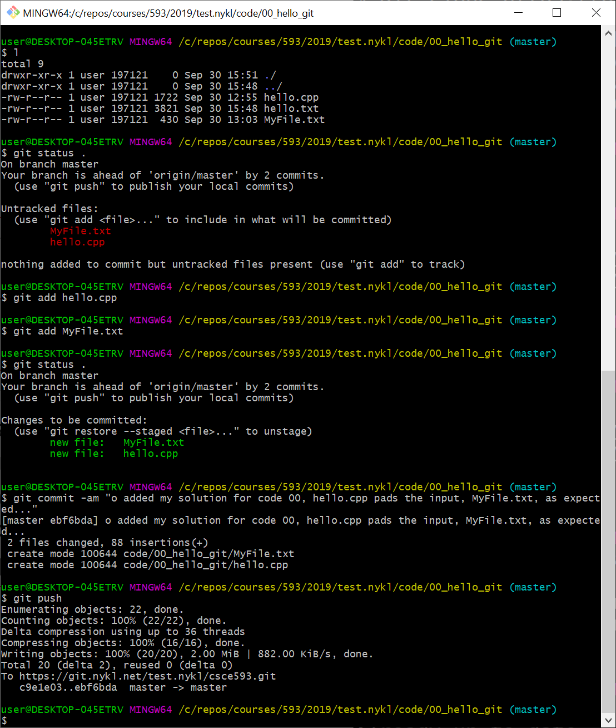
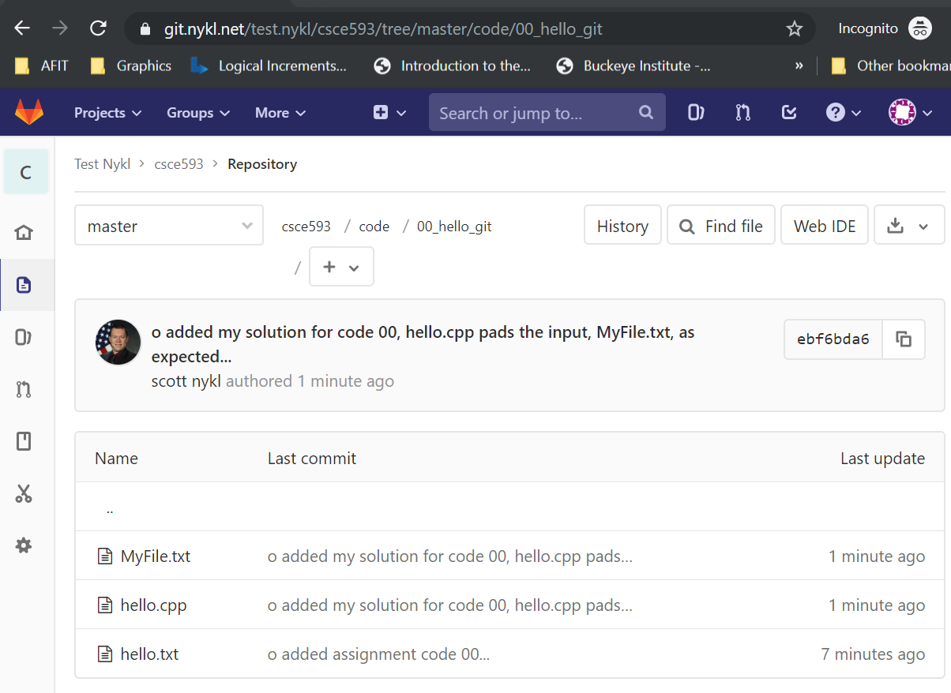
Quick Hello World for GIT – code/00 First git add, git commit, git push

Slide 14
GIT -- DO NOT do these things
Do *NOT* commit temporary Files or Folders to Repo (wastes space)
Do *NOT* add frequently changing binary files to repo (no exes or objs or vcxproj or sln or cwin64/ (will conflict with group members)
Do *NOT* commit passwords in shared repos
Cannot remove a file once it is pushed – it is there “forever”

Slide 15
Cmake – Cross Platform Build Tool
Windows, Linux, OS X, Android, iOS, Arduino, Solaris, FreeBSD
x86, x86_64, x87, ARM32, ARM64, PowerPC, RISC-V
Special Micro-code to accelerate special instructions MMX, SSE, H.265

